Slide 1
ADVENTURE
WORKS

Slide 2
Today’s agenda
Group Details
Adventure works in brief
Summary Of The Project
KPI List
Excel Dashboard
PowerBi Dashboard
SQL
Tableau Dashboard
Challenges and Objectives
Suggestions

Slide 3
Adventure Works In Breif
Adventure Works is a fictional multinational bicycle manufacturing company created by Microsoft for learning and business intelligence projects.
The company manufactures and sells bicycles, bicycle parts, accessories, and clothing.
It operates in multiple regions, including North America, Europe, and Asia, serving customers worldwide.
Adventure Works maintains detailed data on sales, customers, products, employees, territories, and resellers.
The company uses business analytics to monitor sales performance, profitability, customer behavior, and market trends.
The dataset contains information about orders, revenue, costs, products, customer demographics, and sales territories.
The main goal of analyzing Adventure Works data is to generate business insights that support better decision-making and improve overall performance.

Slide 4
Summary Of The Project
  Adventure Works is a multinational bicycle manufacturing company that sells products across North America, Europe, and Asia.
  Identify valuable customers, their purchasing behavior, and buying patterns.
  Compare sales performance across different countries and sales territories to identify high-performing markets.
  Generate insights that help improve sales strategies, reduce costs, increase profitability, and grow market share.
  Determine the best-selling products, product categories, and the most profitable items.
  Identify valuable customers, their purchasing behavior, and buying patterns.
  Analyze the company's sales data to understand business performance and support better decision-making.
  Compare the performance of different product categories and identify top-selling products.

Slide 5
KPI’S List
Total Sales
Total Profit
Total Orders
Profit Margin (%)
Total Customers
Sales Growth (%)
Order Quantity
Top Selling Products
Sales by Region
Top Customers

Slide 6
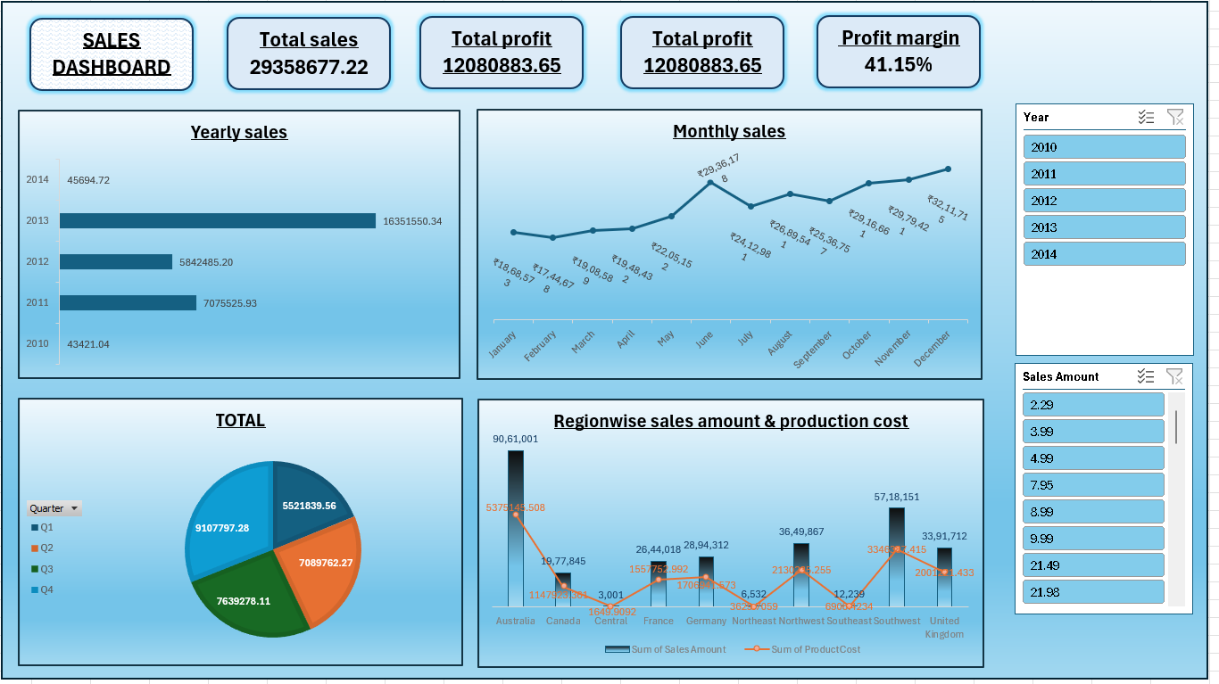

Slide 7
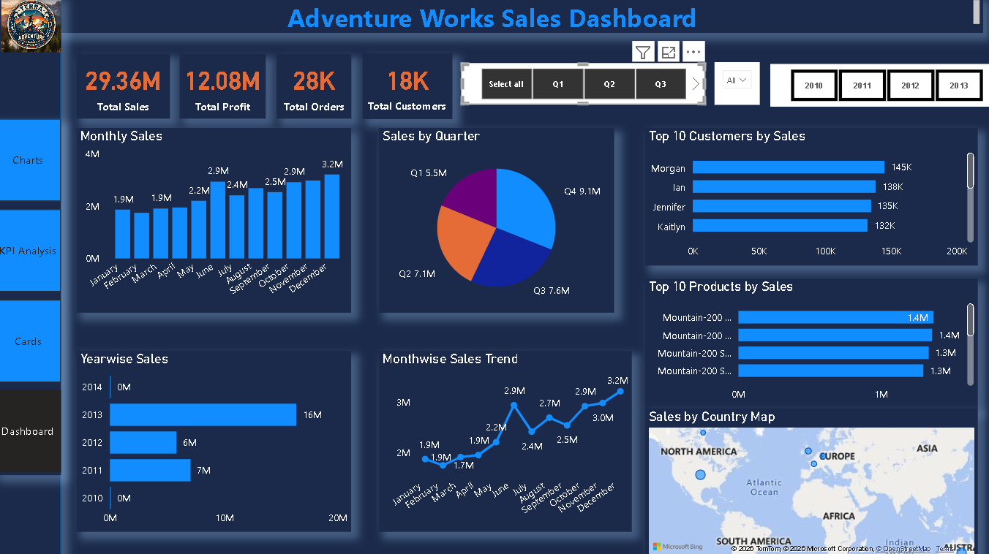

Slide 8
My sql script
FROM FactInternetSales;
SELECT
OrderQuantity,
UnitPrice,
OrderQuantity *
UnitPrice AS SalesAmount
FROM FactInternetSales;
SELECT
OrderQuantity,
ProductStandardCost,
OrderQuantity * ProductStandardCost AS ProductionCost
FROM FactInternetSales;
SELECT(OrderQuantity * UnitPrice) -(OrderQuantity * ProductStandardCost) AS Profit
FROM FactInternetSales;
SELECT
YEAR(OrderDate) AS Year,
MONTH(OrderDate) AS Month,
SUM(SalesAmount) AS TotalSales
FROM FactInternetSalesGROUP BY YEAR(OrderDate),
MONTH(OrderDate)ORDER BY Year,Month;
SELECTYEAR(OrderDate) AS Year,
SUM(SalesAmount) AS TotalSales

Slide 9
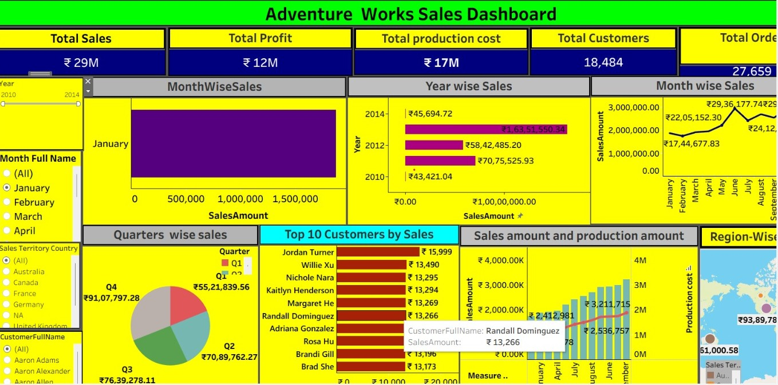

Slide 10
Challenges
Cleaning and transforming raw sales data.
Handling missing, duplicate, and inconsistent records.
Establishing relationships between multiple tables.
Managing large volumes of sales data efficiently.
Creating accurate DAX measures and calculated columns.
Designing an interactive and user-friendly dashboard.
Optimizing dashboard performance for faster loading.
Selecting meaningful KPIs and visualizations.
Identifying hidden trends and business insights from the data.

Slide 11
objectives
Analyze Adventure Works sales data to understand overall business performance. Identify sales trends across different time periods.
Evaluate product category and subcategory performance.
Analyze customer purchasing behavior and demographics.
Measure key business KPIs such as Sales, Profit, Orders, and Revenue.
Compare regional sales performance across different countries.
Identify top-performing and low-performing products.
Create an interactive Power BI dashboard for data-driven decision-making. Provide actionable insights to improve sales and profitability.
Support business decisions through visual analytics and reporting.

Slide 12
suggestions
Increase marketing efforts in low-performing regions.
Focus on promoting high-profit products.
Reduce returns by improving product quality and customer support.
Offer personalized discounts to loyal customers.
Improve inventory planning based on demand trends.
Increase sales during off-peak months through seasonal promotions.
Expand business in high-performing regions and markets.
Introduce cross-selling and upselling strategies.
Monitor sales and profit using real-time dashboards.
Optimize pricing based on product performance and customer demand.

Slide 13
THANK
YOU

